Slide 1

CoderDojo
Scratch Beginners
Code and notes by permission Michael Madden, 2012

Slide 2
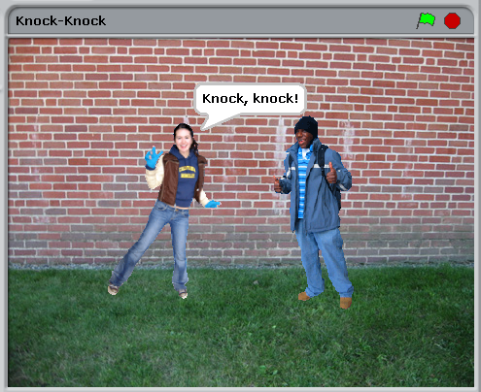
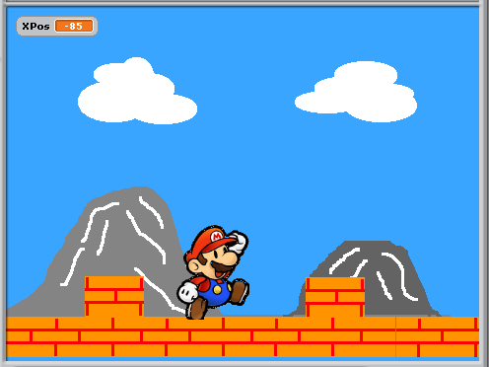
Today's Challenge: More Animation Storytelling and Scrolling!

Slide 3
Today's Big Ideas
Speech Bubbles & Sound
Loops & Timing
Sprites
Imagination!

Slide 4
Telling A Story
Your sprites can be actors in your own story or joke!

Slide 5
How To Do It
Pick some sprites
Decide what they should do & say
Use times and waits so they sync up

Slide 6
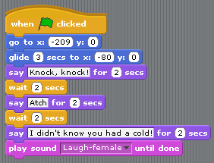

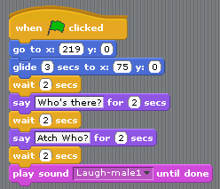

How To Do It: The Code
Make sure these times match
And these!

Slide 7
You Can Do Lots More!
Think of new stories or jokes
Record voices on the Sound tab
Animate with different costumes
Use Broadcasts for more syncing

Slide 8
Another Challenge: Scrolling Backgrounds
Stage can't move: need to use sprites for moving background

Slide 9
The Scratch Stage
480
240,180
0,0 +
360
y
-240,-180
x
Sprites can't be bigger than stage: max length is 480 also

Slide 10


To make it look like Mario is moving Right …
Don't move Mario,
Move the ground Left
x
Sprites can't be bigger than stage: max length of each one is 480,
so we need at least two of them.
Add more to make ground longer.

Slide 11


How to do it, Part 1 …
Make a variable XPos: x-position of the first ground sprite.
The second ground sprite will be at x-position XPos + 480.

Slide 12
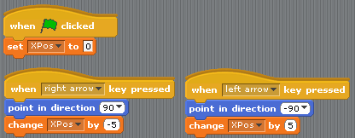
How to do it, Part 2 …
Reducing XPos makes the ground move to the left, to give impression that Mario is moving right.

Slide 13
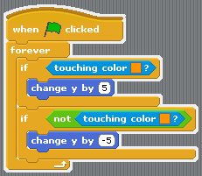
Make Mario stand on the ground …
y
If below ground (touching colour), move Mario up a bit.
If above ground (not touching colour) move Mario down a bit.

Slide 14

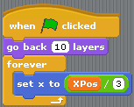

Advanced Idea: Parallax Effect
Mountains appear to move more slowly, so change their XPos by a smaller amount.
Also need to consider layers: the ordering of the sprites.

Slide 15
At the End …
Upload your project to the Scratch Website user: emcdojo password: cork123
Access it from home
Improve it
Show your friends!

